Slide 1
Context Engineering, RAG & System Architecture

Slide 2
Context Engineering, RAG & System Architecture
  Context Design for LLM Systems
  RAG Architecture & Data Pipelines
  End-to-End System Design

Slide 3
What is Context in Generative AI?
Context = All information given to LLM at inference time
  Includes:
  System instructions
  User query
  Chat history
  Retrieved documents
  Tool outputs
  Persistent memory
  Model responds ONLY based on available context window

Slide 4
What is Context Engineering?
Structured design of LLM input before generation
  Involves:
  Selecting relevant data
  Removing noise
  Structuring & ordering inputs
  Managing token limits
  It is a system-level discipline, not just prompt writing

Slide 5
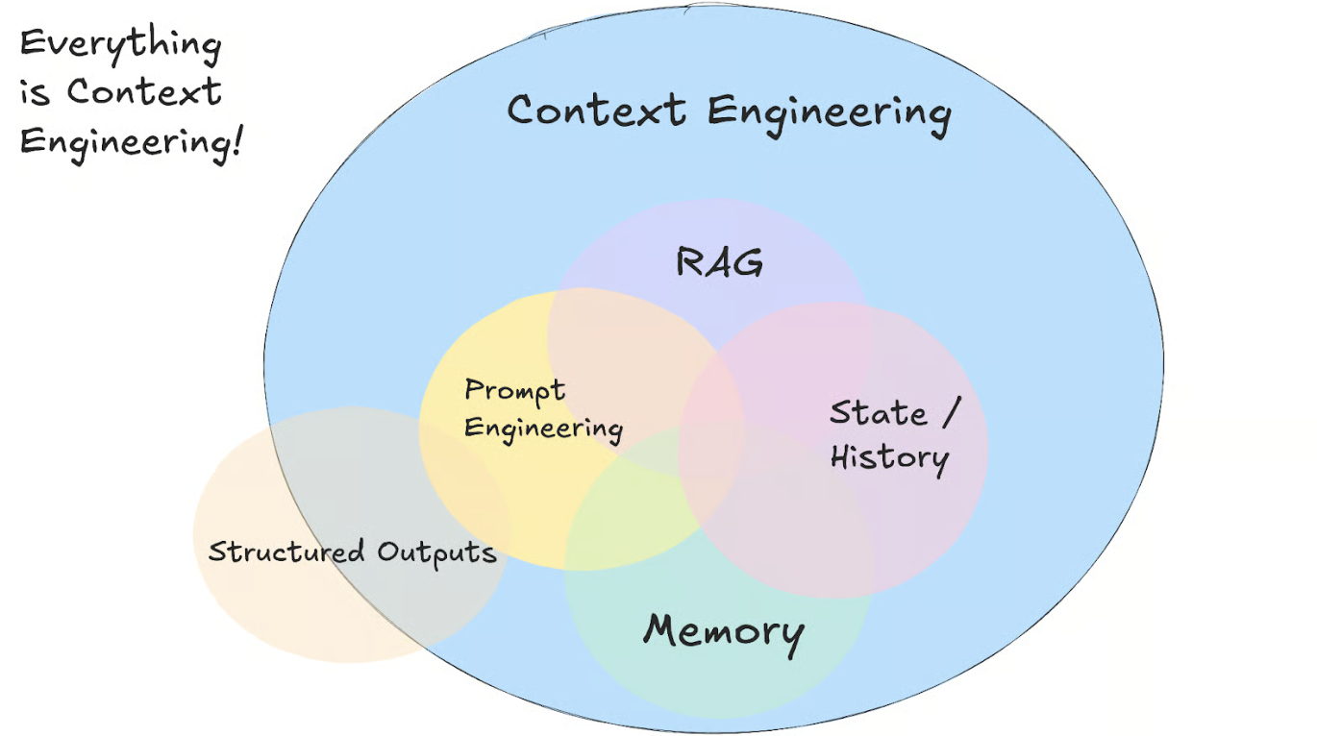
What is Context Engineering?

Slide 6
Context Engineering vs Prompt Engineering
Prompt Engineering
  Focus: Instruction wording
  Static interaction
  Single-response optimization
  Context Engineering
  Focus: Data pipeline design
  Dynamic & retrieval-driven
  End-to-end architecture approach

Slide 7
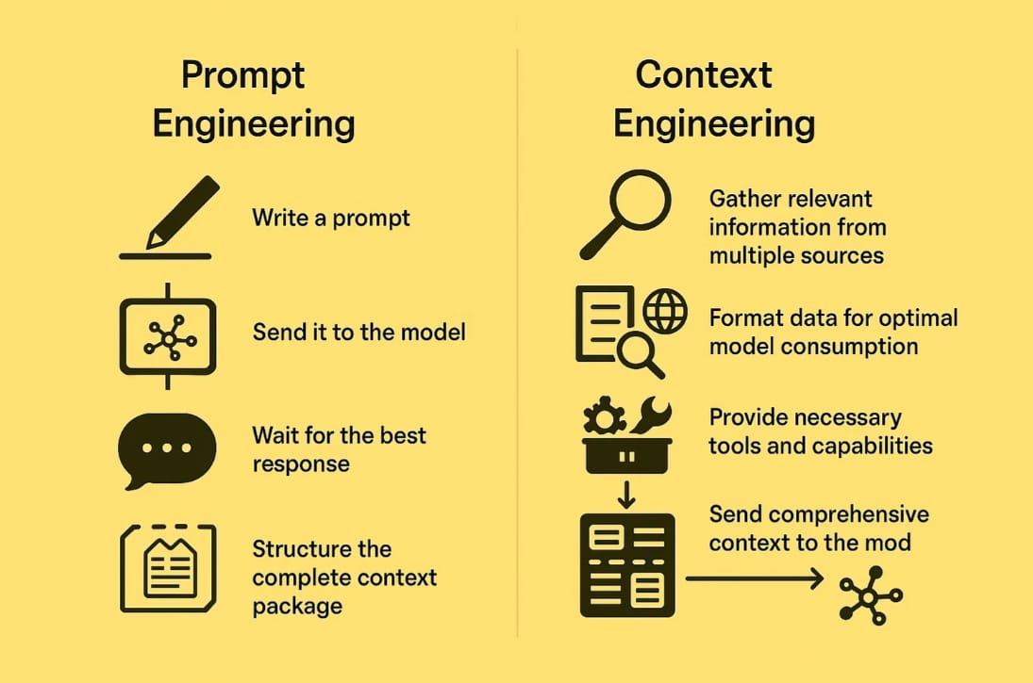

Slide 8
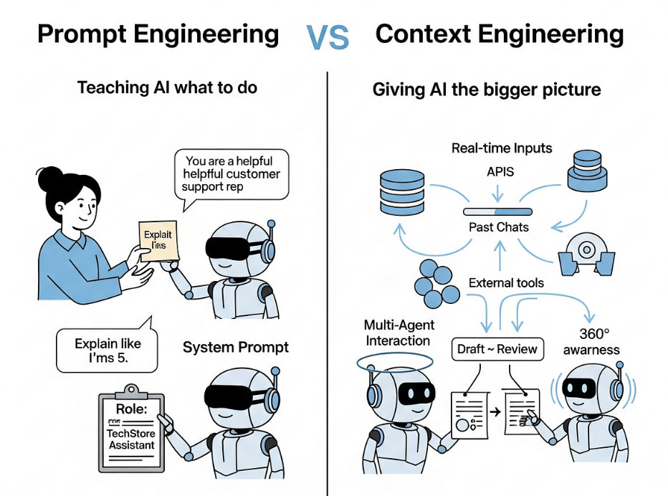

Slide 9
Context Engineering in Agentic AI
Agents can:
  Retrieve knowledge
  Call tools/APIs
  Maintain memory
  Perform multi-step reasoning
  Context engineering ensures:
  Correct memory availability
  Structured tool outputs
  Reliable state preservation

Slide 10
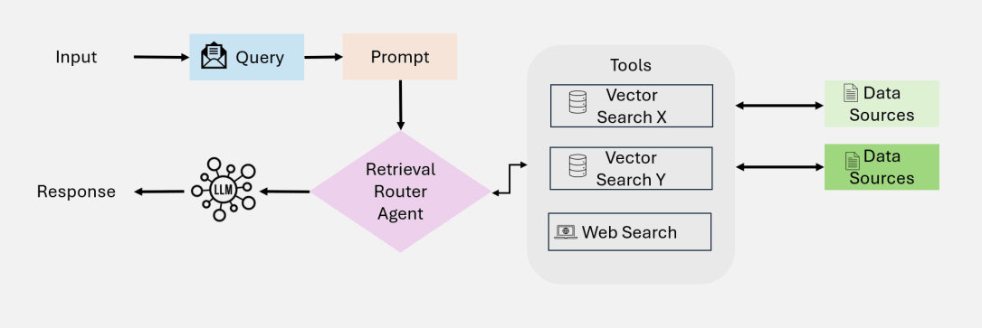
Context Engineering in Agentic AI

Slide 11
Types of Context
Instruction Context
  User Context
  Conversational Context
  Knowledge Context
  Tool Context
  Memory Context
  Each type plays a role in improving reliability.

Slide 12
Why Context Engineering Matters for Your Product
Context poisoning: Hallucinations contaminating future responses.
Context distraction: Too much information overwhelming the model.
Context confusion: Conflicting information causing errors.
Context clash: Disagreeing sources and instructions leading to inconsistent outputs.

Slide 13
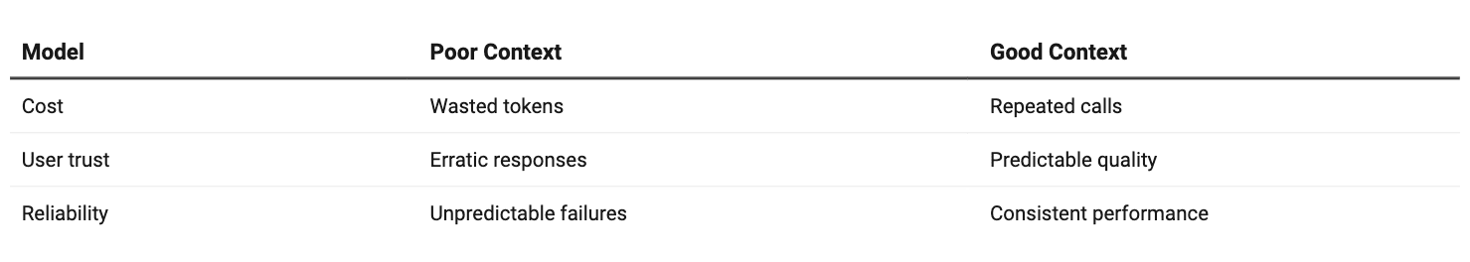
Why Context Engineering Matters for Your Product

